Slide 1
Automated Fitness Instructor Certification Website
sddec19-04
David Bane, Ryan Menster, Max Talley, Christine Hicaro
Advisor: Mohamed Selim
https://sddec19-04.sd.ece.iastate.edu/

Slide 2
Project Background
Original client: Farrell’s Extreme Bodyshaping
Project was started by a previous intern
Given a UI template with fake data
Halfway through semester, client cancels the project
Will refer to client as AFIC from now on
Max Talley
Notes:
Change title names

Slide 3
Project Plan

Slide 4
Problem Statement
Problem
Instructor records are maintained by hand
Certifications are updated manually
Time consuming process
Proposed Solution
Bring certification process online
Records will be updated automatically
Vastly decrease record maintenance time
Max Talley

Slide 5
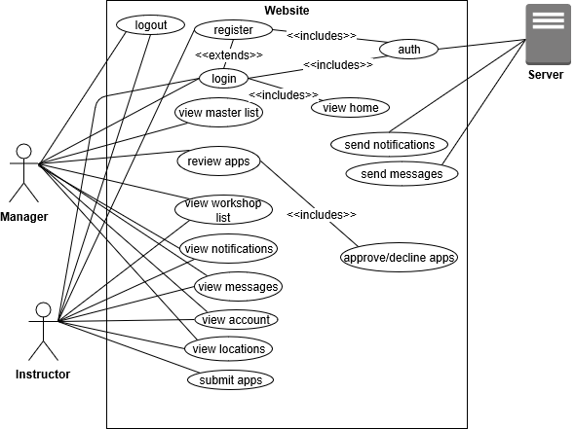
Use Cases
3 actors
Instructor
Apply for Certification
Attend Workshops
View Location Information
Manager
Register new Trainer/Instructor
Approve/Decline Certification Applications
Server
Sends messages between users
Sends notifications to all users
Ryan Menster
Notes:
Fix ss

Slide 6
Functional Requirements
A well constructed database schema
Database must be efficient and intuitive
Displaying lists
Instructor, workshop, and location lists
Authentication of an employee or instructor
Checks must be made for verification of employee or instructor
Use of individual trainers data
Used for automating instructor certification
Christine Hicaro

Slide 7
Non-Functional Requirements
System should only be accessible by instructors and managers
Database should be completely secure and accessible only by management
Both the web server and database should be set up in a maintainable way
Christine Hicaro
Notes:
Time: 3 minutes

Slide 8
Constraints & Considerations
Constraints
Extensive database information is unknown
Maintaining IEEE and ABET standards
Time
Considerations
Continue with initial website or rebuild
Rebuild as angular is deprecated
Creating a system that can be maintained by a different team of developers
AWS or Azure
Instructor or manager privileges
David Bane

Slide 9
What makes our project unique?
Client has a proprietary certification
No product on the market is built around this
We needed to build something that can support their certification and management process
Max Talley

Slide 10
Potential Risks & Mitigation
We no longer have a client
Client left the project due to unforeseen circumstances
We decided to continue with the initial project
We have enough information from the client to continue and finish the project
Group member schedules do not line up
Very few opportunities to meet
We make sure to reserve the times when we are all available
We have utilized online meetings, email, and group messaging apps (GroupMe)
Limited group knowledge on languages used
React, Express, Microsoft Azure
We took time to self study these languages
Ryan Menster

Slide 11
Resource Cost Estimate
Azure is our only expense
Server will cost us about $25/month
Database will be about $30/month
Total Cost per Month: $55/month
Total Cost per Semester: $220
Max Talley
Notes:
Know the average cheaper than aws for azure

Slide 12
Project Milestones
Chose to use Agile
Allows for continuous integration and client communication
Iterative process works well for our senior design project
Primary Milestones
Frontend Implementation
Web pages, User Interface, etc.
Backend Implementation
Routing, Certification Verification, Message Handling, etc.
Database Implementation
Account Creation, Data Retrieval/Additions, etc.
Ryan Menster

Slide 13
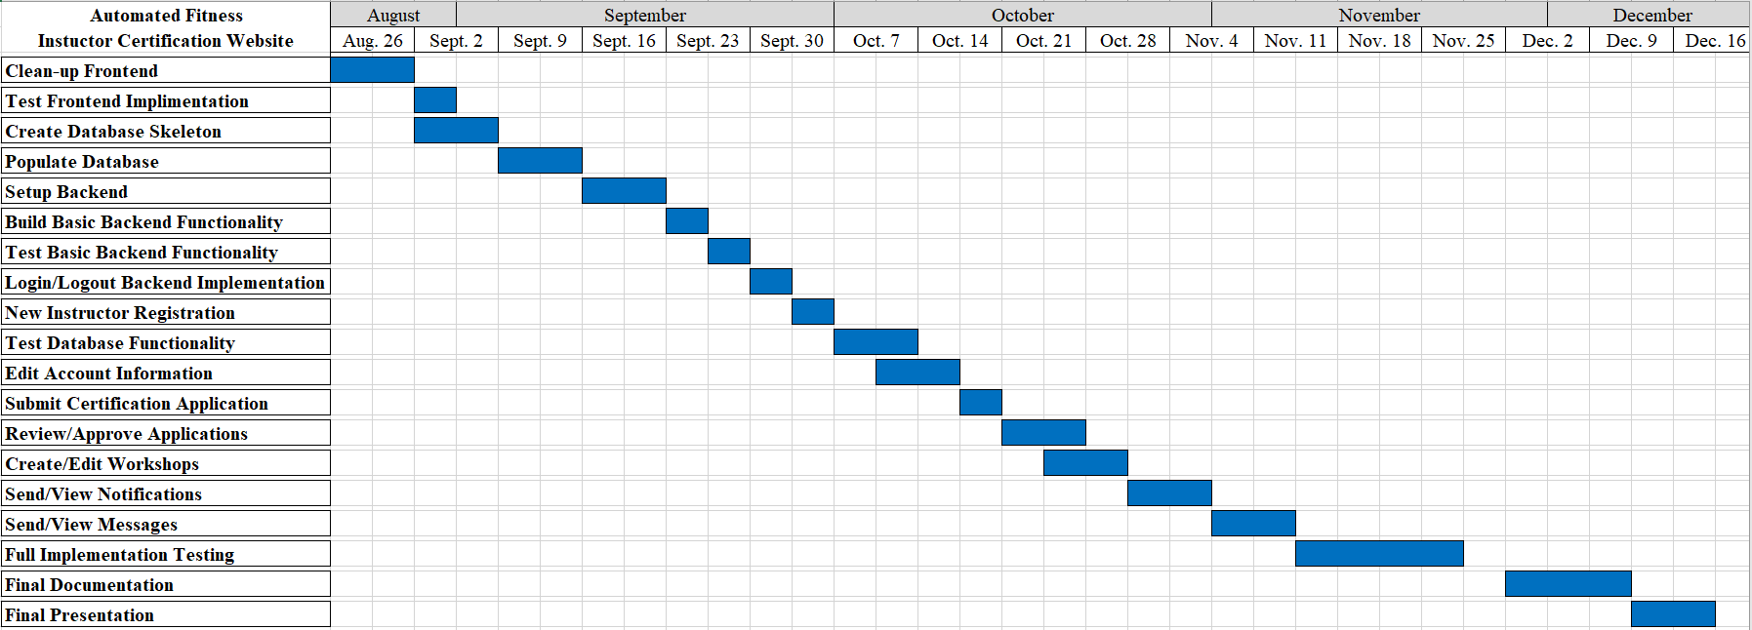
Project Gantt Chart
Ryan Menster

Slide 14
System Design

Slide 15
Functional Decomposition
MVC Styled Architecture
Model: Sequelize Database
Manages all of our data to be viewed
View: React components
Present the data
Front-end
Controller: Express
Processes the user input accordingly
Back-end
David Bane

Slide 16
Detailed Design
What is:
A framework?
The big draw for using a framework is its componentization
Reusable code, easily pass data, logic easily handled
React & Material UI
A backend?
Handles the logic of managing data between the frontend and database
Express
A database?
Store complex data with connections to each other
Data accessible through queries
Sequelize, a Node.js ORM
A cloud service?
Stores our data and runs the server
Microsoft Azure
David Bane
Notes:
ORM - object relation mapping - query and manipulate data from a database using an object-oriented designed

Slide 17
Technology Used
React Frontend
Material.io
Express Backend
Sequelize Database
Microsoft Azure Cloud Service
Max Talley

Slide 18
Test Plan
Functional testing
Unit, integration, and acceptance
Integrity testing/code coverage
Can use a tool like Coveralls or Codecov
Non-functional testing
Testing for performance, security, usability, and compatibility
Christine Hicaro
Notes:
11:50 minutes!!

Slide 19
Current Project Status
Frontend currently under development
6 primary web pages have been created
Next pages to complete: Login/Logout and Account Page
Backend/Database implementation begins next semester
First major milestone, finishing the User Interface, is about 50% complete
Many smaller milestones have been completed
Project is in early stages, but we are right on schedule
Ryan Menster

Slide 20
Product Design

Slide 21
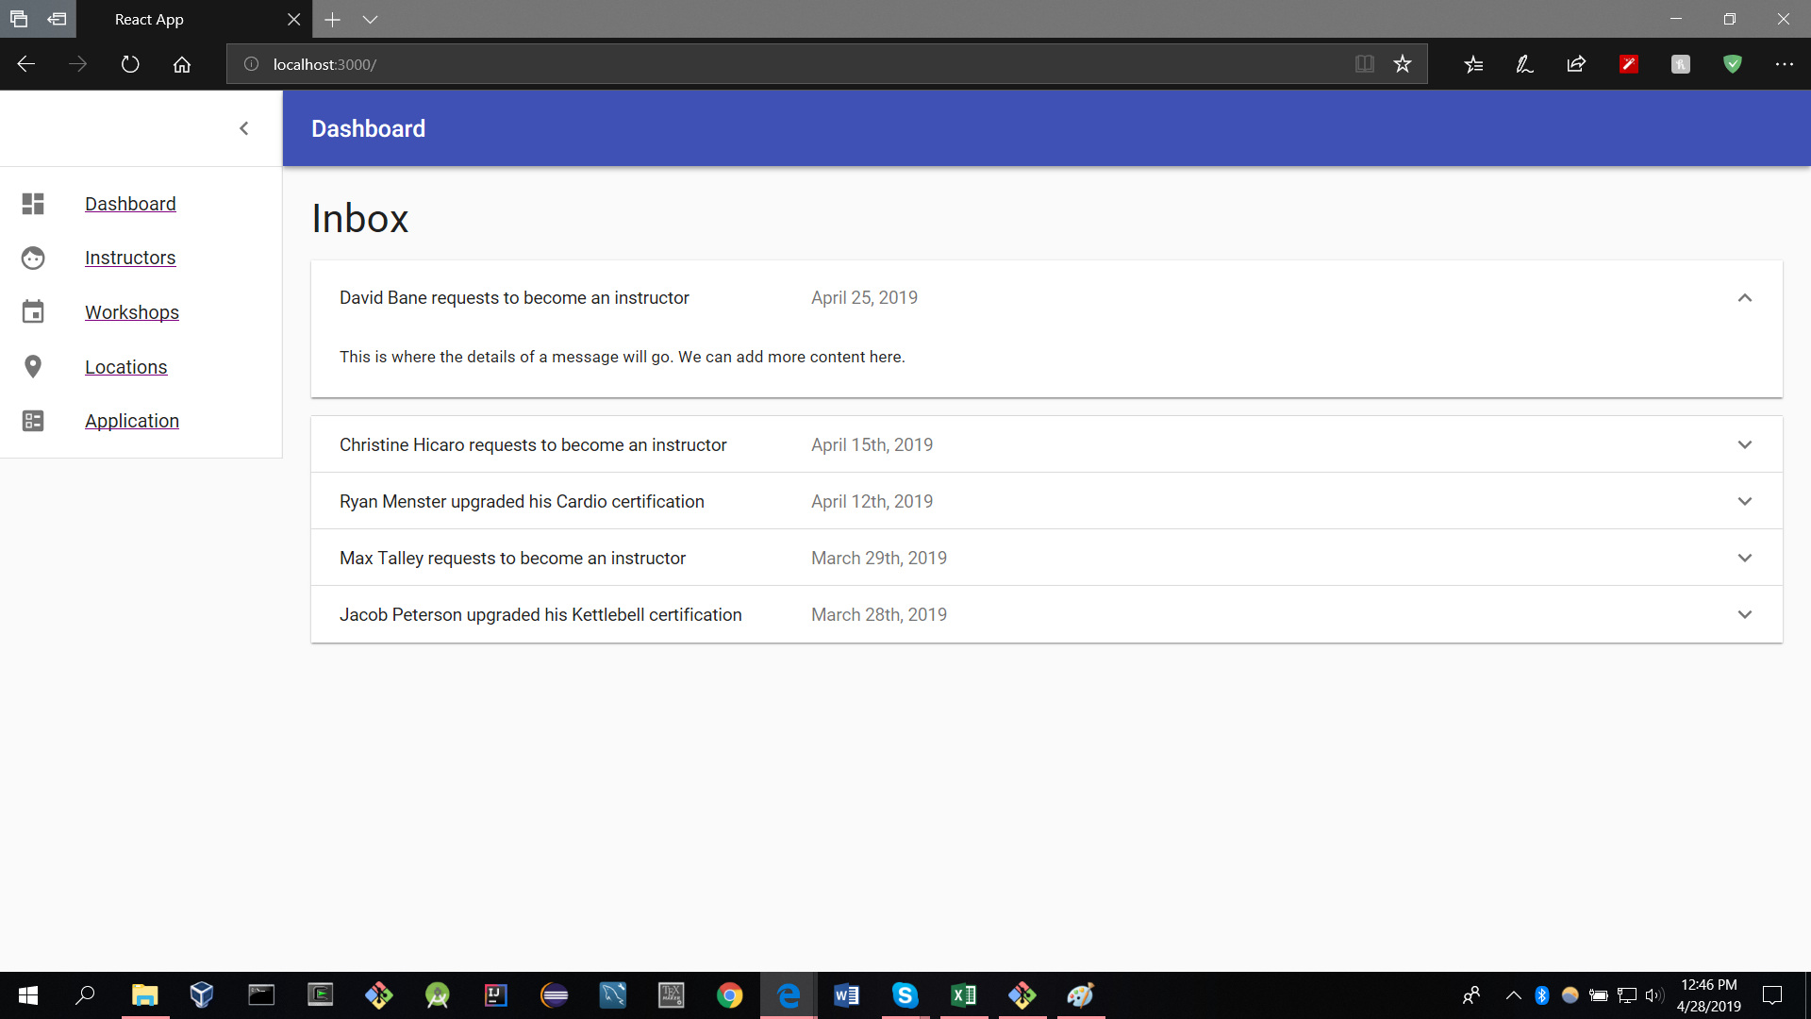
Notes:
Slide before into for demo

Slide 22
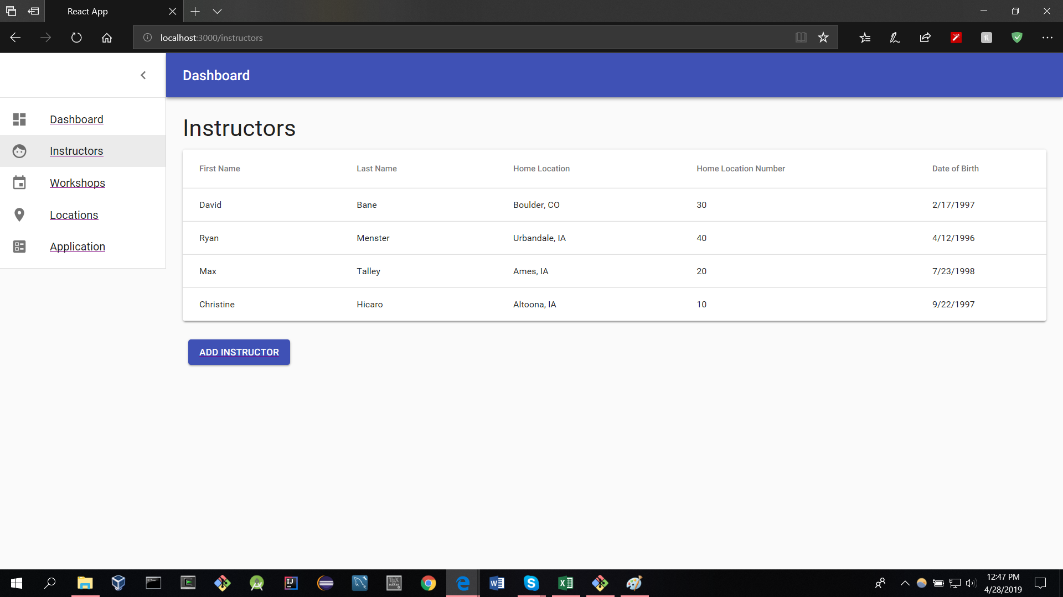

Slide 23
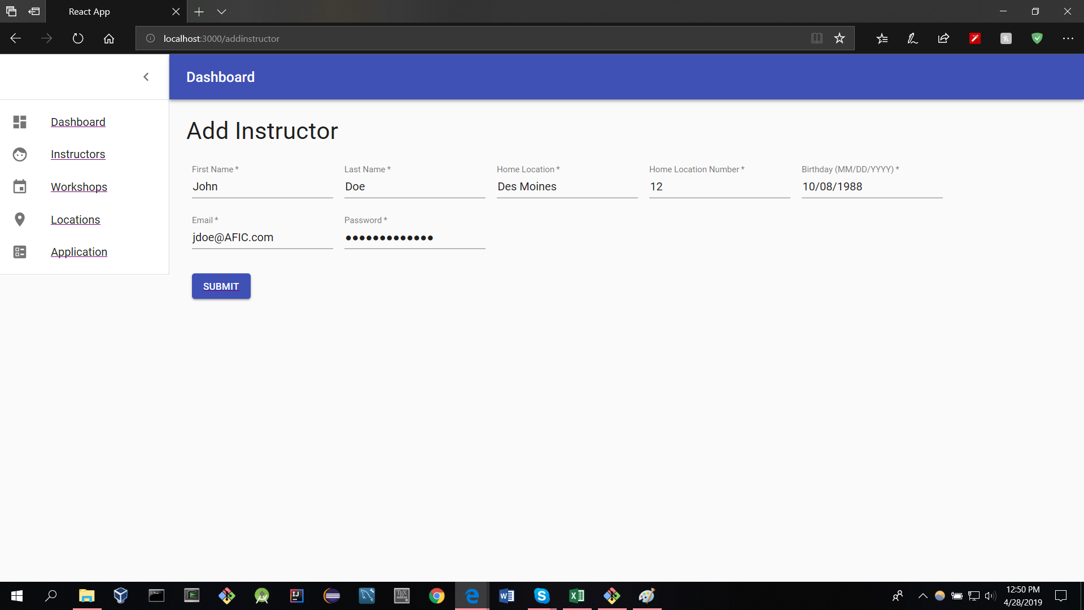

Slide 24
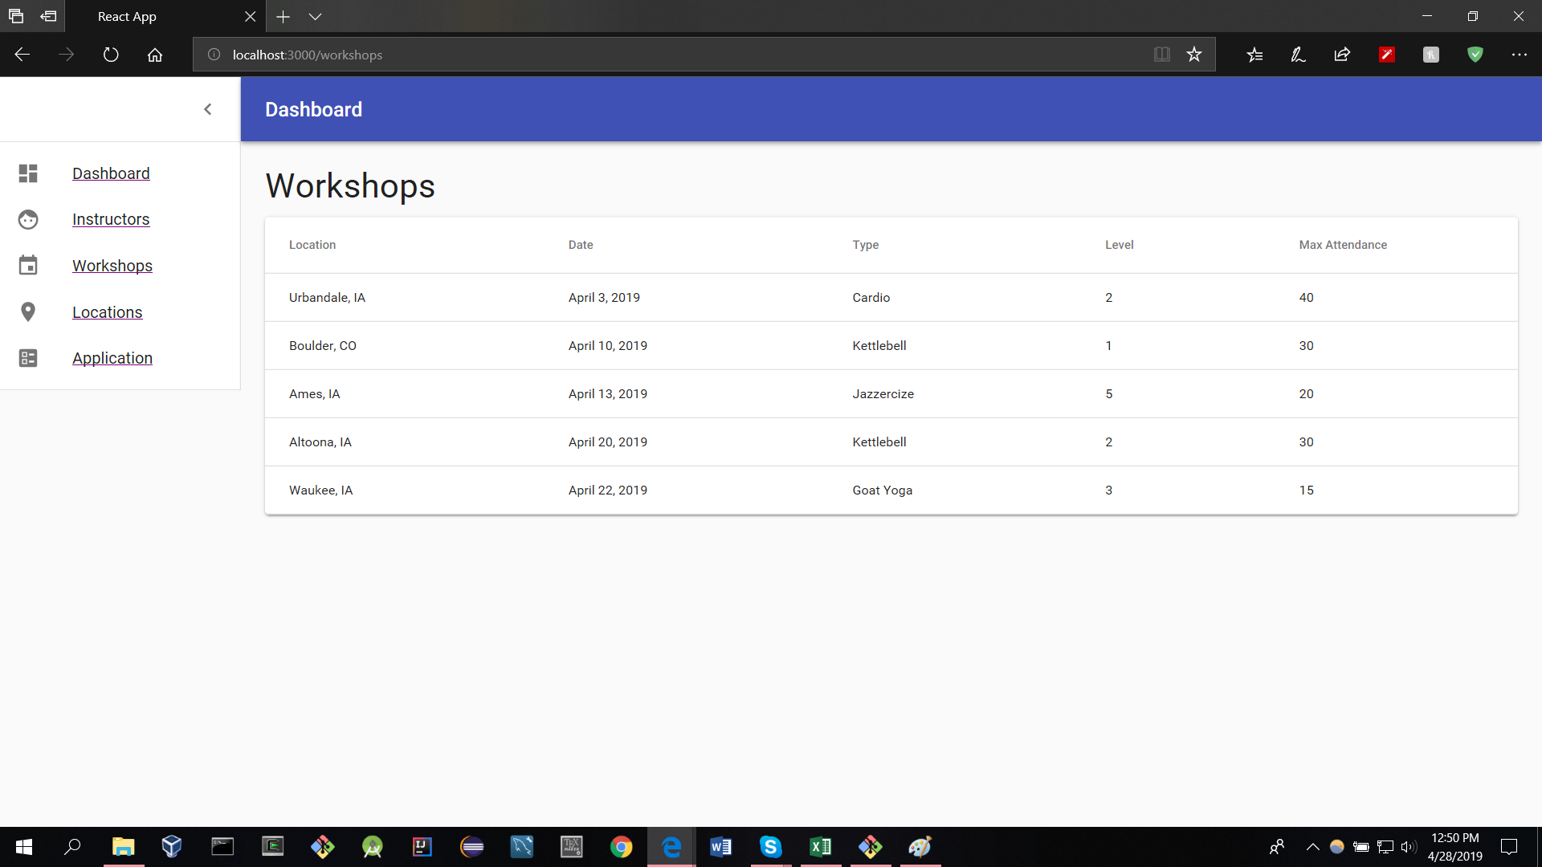

Slide 25
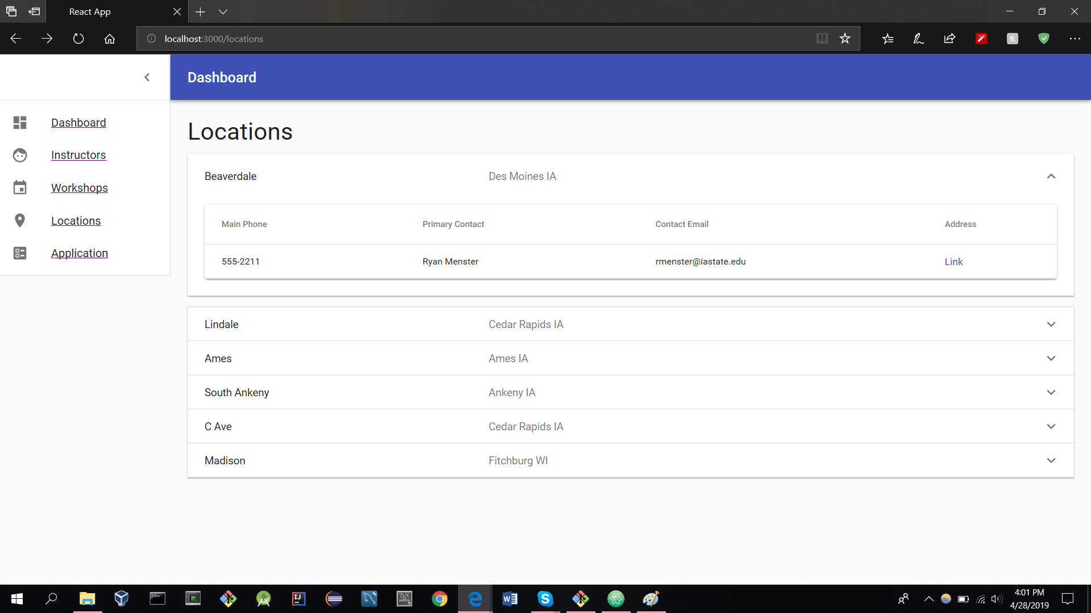
Notes:
15:30 <<<><><><>

Slide 26
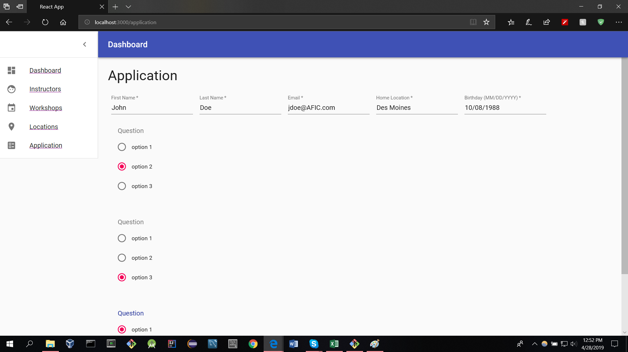

Slide 27
Group Roles
David: Group Facilitator
Ryan: Database Administrator
Max: Group Scribe
Christine: Group Administrator
David, Ryan, Max,Christine

Slide 28
Plan for next semester
Finish the front end user interface
Design our database schema
Setup Microsoft Azure
Integrate Express routing
Develop our certification approval algorithm
Producing a final product
David Bane
Notes:
20 min presentation 5 questions 5 change/overtime
Compare overall time talked for each person
19:30

Slide 29
Thank you

