Slide 1
Automated Fitness Instructor Certification Website
sddec19-04
David Bane, Ryan Menster, Max Talley, Christine Hicaro
Advisor: Mohamed Selim
Client: Mohamed Selim
https://sddec19-04.sd.ece.iastate.edu/

Slide 2
Project Overview

Slide 3
Group Introduction
David: Group Facilitator
Ryan: Database Administrator
Max: Group Scribe
Christine: Group Administrator
David, Ryan, Max,Christine

Slide 4
Project Background
Original client: Farrell’s Extreme Bodyshaping
Project was started by a previous intern
Given a UI template with fake data
Halfway through last semester, our client canceled the project
Mohamed Selim (Advisor) became our client
Will refer to the client as AFIC from now on
Max Talley

Slide 5
Problem Statement
Problem
Instructor records are maintained by hand
Certifications are updated manually
Time consuming process
Proposed Solution
Bring certification process online
Records will be updated automatically
Vastly decrease record maintenance time
Max Talley

Slide 6
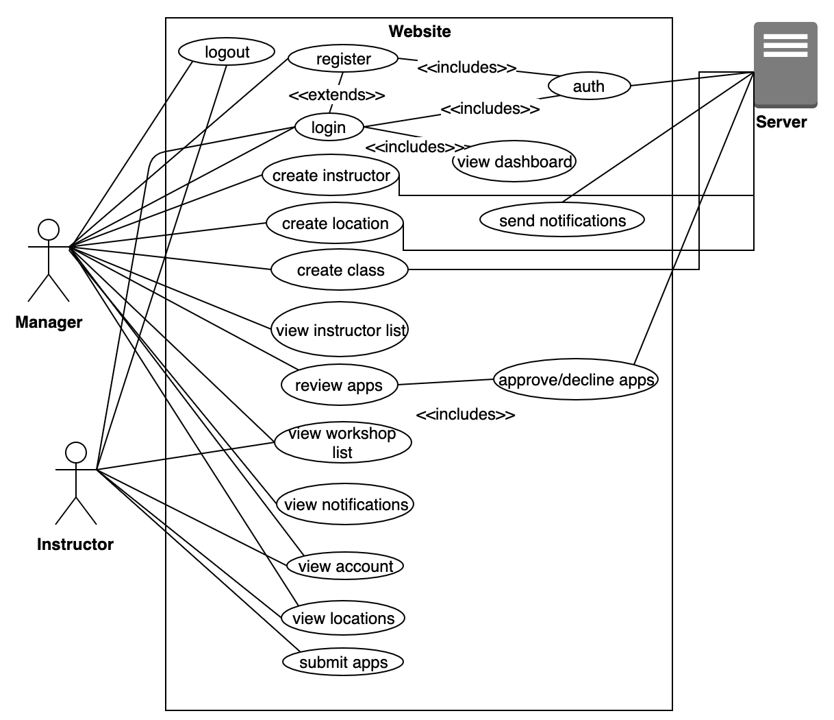
Use Cases
3 actors
Instructor
Apply for Certification
Attend Workshops
View Location Information
Manager
Register new Instructors
Approve/Decline Certification Applications
Server
Sends data between modules
Sends notifications to Managers
Authorize users via Auth0
Ryan Menster

Slide 7
Project Gantt Chart
Ryan Menster

Slide 8
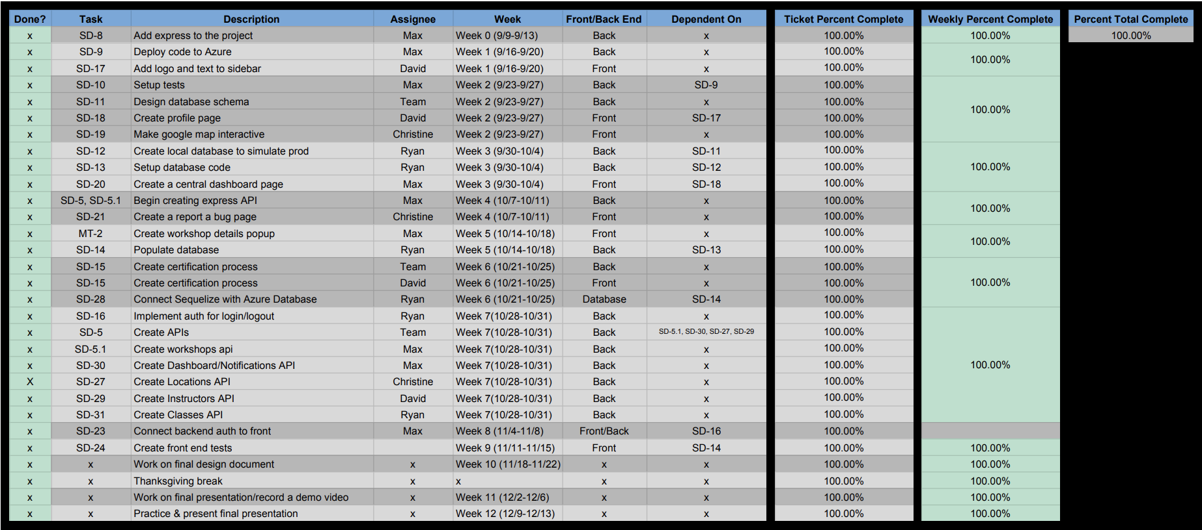
Project Semester Plan
Ryan Menster
Notes:
Convert into GANTT chart and add to previous slide

Slide 9
System Design

Slide 10
Functional Requirements
A well constructed database schema
Relations are designed well
Authentication of an employee or instructor
Checks must be made for verification of manager or instructor
Displaying all relevant AFIC data to users with different permissions
Instructor, workshop, and location lists
Use of individual trainers data
Used for automating instructor certification
Managers have final approval of application
Users can manage their own account data
Christine Hicaro

Slide 11
Non-Functional Requirements
Only authenticated users are allowed to access the service
Users are allowed to only see the data they are authorized to
Managers and instructors have different permissions
The website does not crash and is easily maintainable
The website will be intuitive and easy to use
Both the web server and database should be set up in a maintainable way
Christine Hicaro

Slide 12
What makes our project unique?
While a concept of this sort is not brand new it had its own challenges
The combination of modules used
Any combination comes with different challenges
Client has a proprietary certification
We needed to build something unique to support their certification and management process
David Bane

Slide 13
Resource Requirements
Microsoft Azure
Found a free student package
Developers
Our team
David Bane

Slide 14
Risks & Mitigation
Security of user data
Database could be hacked and user information could be stolen
However, the only sensitive information we store is a user’s email
Auth0 manages user our authentication and are trusted in industry
We did not have a client
Client left the project due to unforeseen circumstances
We decided to continue with Dr. Selim as our client
We have enough information from the client to continue and finish the project
Made our business decisions as well as development decisions
David Bane
Notes:
Add in what our options were for continuing the project

Slide 15
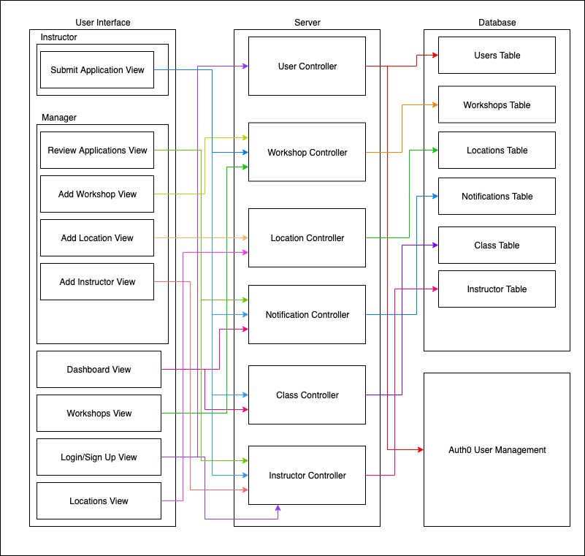
System Analysis
User Interface
Instructor views
Manager views
Combined views
Server
API controllers
Database
Tables and relations
Authentication with Auth0
Max Talley
Notes:
Move Automated Fitness… to the bottom to give more vertical space - i believe this is fixed in a template

Slide 16
Functional Decomposition
MVC Styled Architecture
Model: Sequelize
Manages all of our data to be viewed
Relations
View: React components
Present the data
Front-end
Controller: Express
Processes the user input accordingly
Back-end
David Bane

Slide 17
Design in Detail

Slide 18
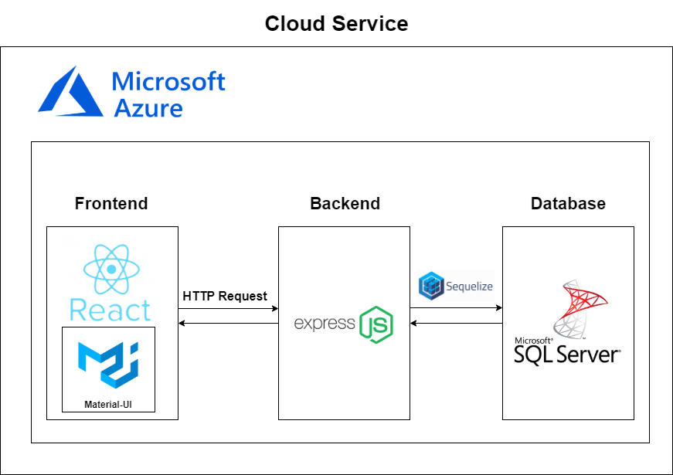
Technology Used
Ryan Menster
Notes:
Ryan

Slide 19
Design Decisions
React vs Angular
Original site was built in the deprecated AngularJS framework
React is well documented with a large community
React is most commonly used in industry
Express vs Laravel
Express is written in JavaScript and Laravel is written in PHP
JavaScript knowledge was limited, and nobody knew PHP
Easier to keep everything in JavaScript so we could learn and develop faster
Microsoft Azure vs Amazon Web Services
Both have student packages
MS Azure had better support and a friendlier UI
Have to pay for AWS support
Sequelize
Only ORM framework we considered for use with our database
Framework is extensive and covers all of our needs
Christine Hicaro
Notes:
Tradeoffs:
React vs. Angular
Had to remake the website from scratch
Express vs Laravel
Don’t get to learn new languages. Sacrifice PHP benefits
Azure vs AWS
- AWS more widely used. More tools available via AWS
Sequelize
- No tradeoff. Didn’t consider other options

Slide 20
Testing

Slide 21
Test Plan
User testing
Security testing
Testing that the different authorization groups can only access pages in their permissions
Test that site content can’t be accessed without successfully authenticating first
User interface testing
Testing UI for flaws
Testing pages for logic errors
Max Talley
Notes:
Person on computer clipart
Max

Slide 22
Lessons Learned
Changing the order of module implementation
The order we went in was front end to API to Auth
Wanted to visualize the plan
Wanted to connect the visual with the data
Wanted to secure the whole package
Should have gone Auth to API to front end
Should have created the security
Should have added and displayed the raw data securely
Should have then made the data look right
David Bane

Slide 23
Future Work
Show the managers whose attending workshops
Redirection Reloading bug
Improving Input validation
Better error reporting
More visually pleasing UI
APIs could be revised
Increase website response speed
Ryan Menster

Slide 24
Demo

Slide 25
Ryan Menster
Notes:
Delete?

Slide 26
Summary
Created an application that automates instructor certification process
Built with React, JavaScript, Express, Sequelize, and Microsoft Azure
Got most of the requirements from the initial client and we were able to build on that throughout the semester
Main purpose of our application is complete although improvements can always be made
Max Talley
Notes:
Christine - didn’t exactly know what to put on this slide besides the first two bullet points...

Slide 27
Thank you

